Slide 1


The
IG2
Programmation Web II
English for the Web
Project
A project and presentation by ADAM Jessy

Slide 2
This presentation will include :
A description of the applicvation itself;
The technologies used;
The languages used;
Any adventages/disadventages of them;
Things that could’ve changed if I were given more time;
And a demonstration of the application itself;

Slide 3


What is it ?
+
Based on the work of Corey Schafer
October 10th - December 26th

Slide 4




Slide 5





Technologies
Because that’s what was asked.
django-crispy-forms

Slide 6





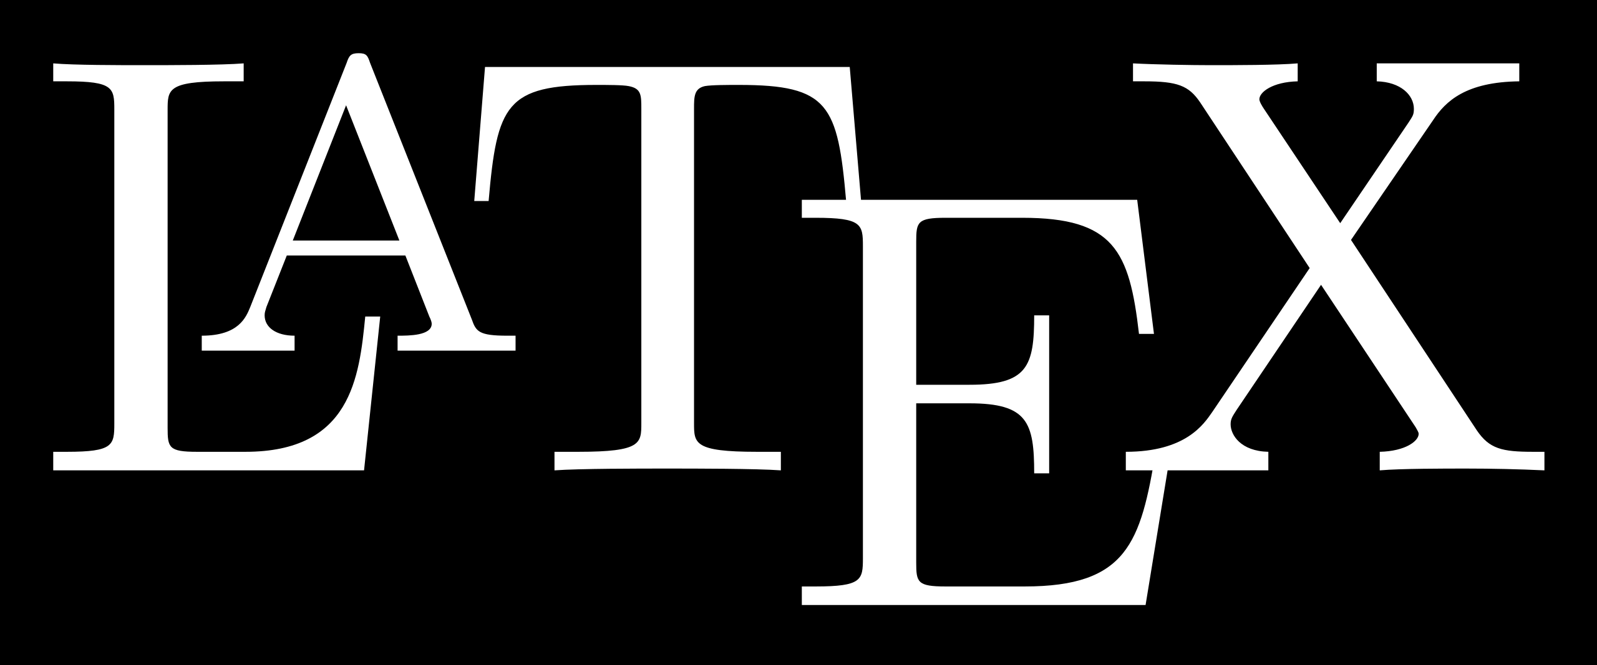
Languages

Slide 7
Advantages/Disadvantages
It’s new,
It’s different,
And therefore
It’s bad.

Slide 8
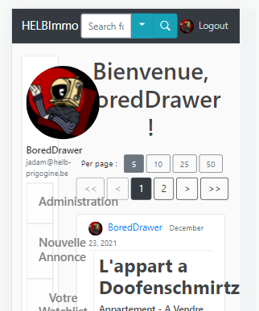
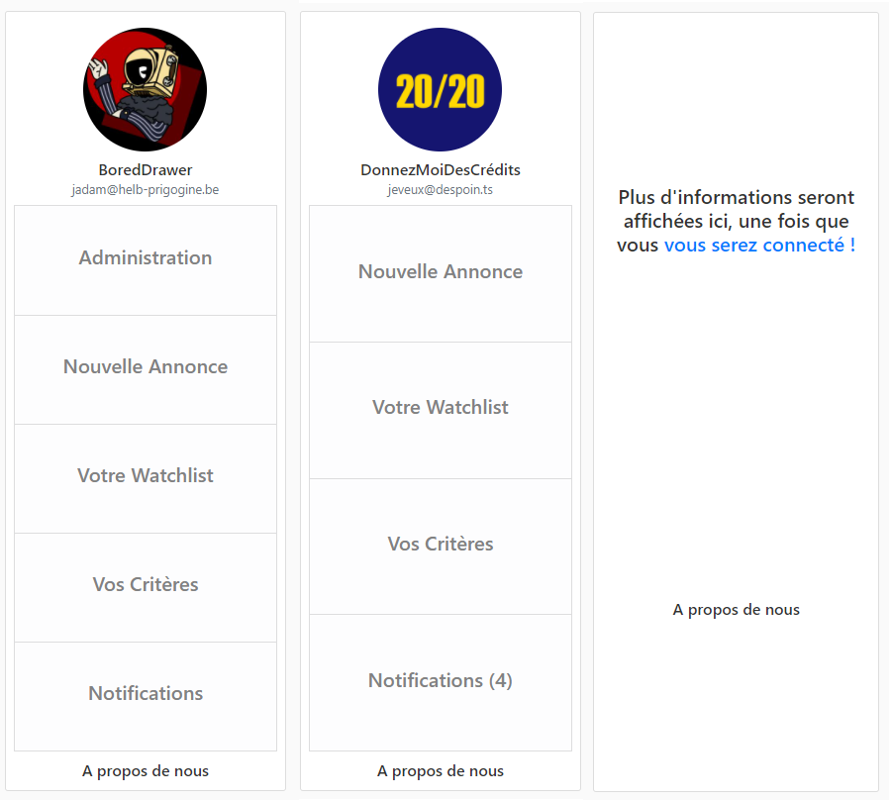
What could’ve been
Improve responsiveness
Redesign the sidebar
Bad

Slide 9
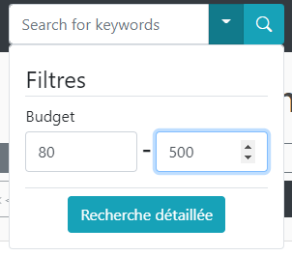
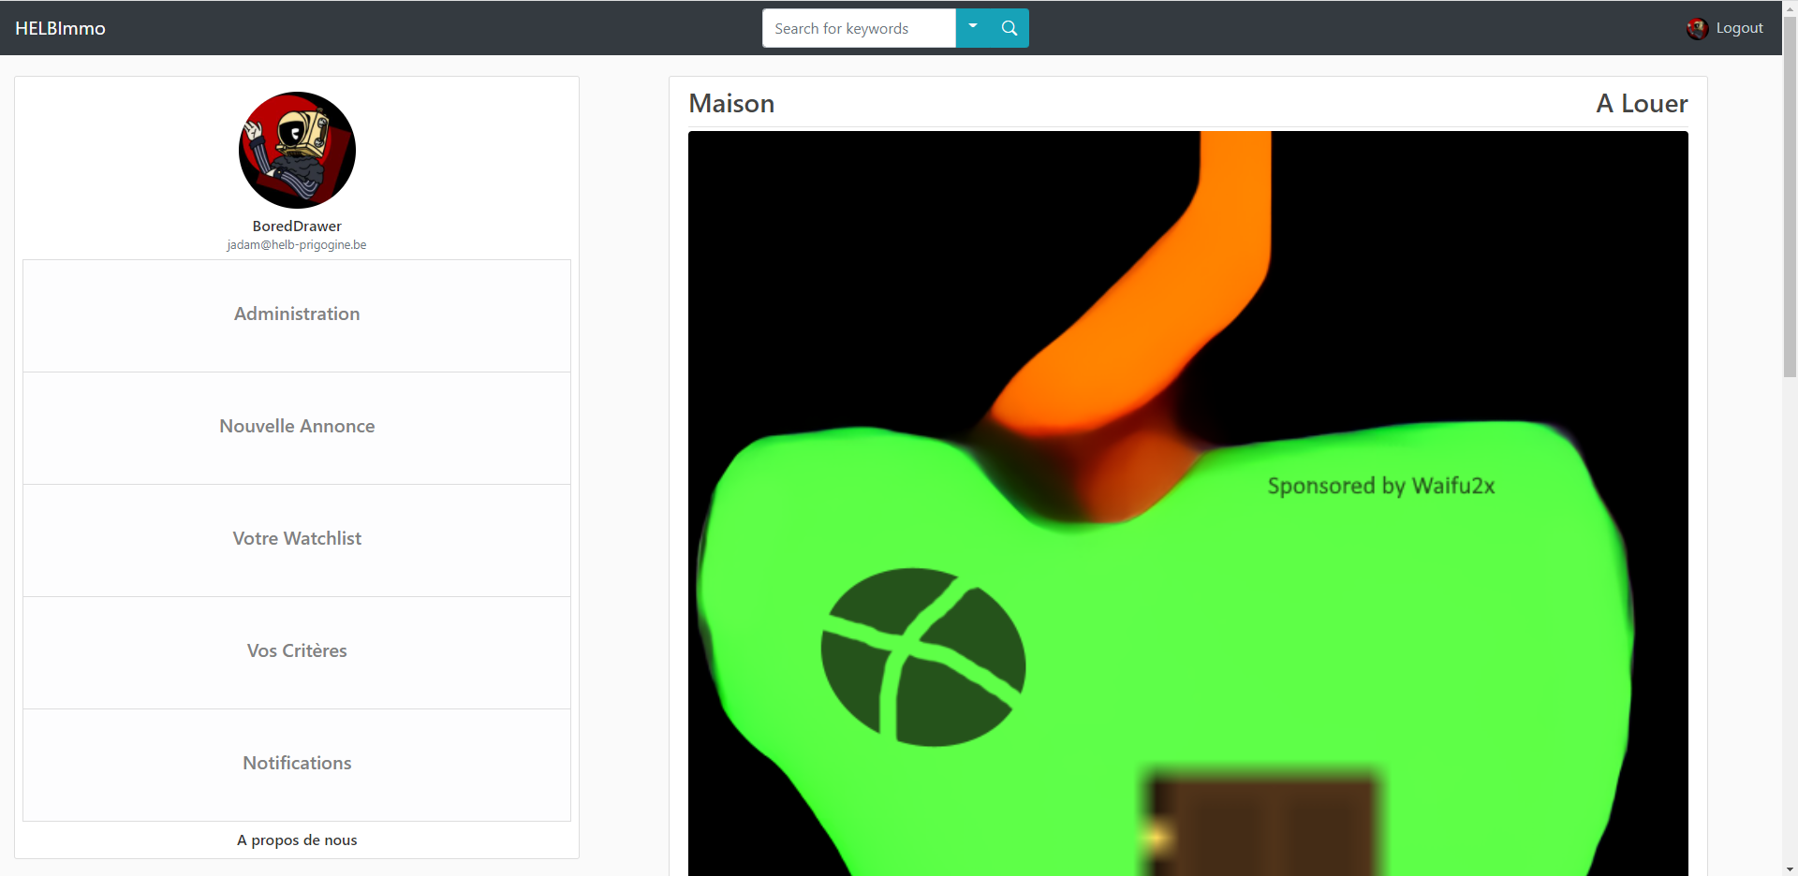
What could’ve been
Clean up the code & make it more cohesive
Make notifications for questions
Fix
Etc.

Slide 10



What could’ve been
My duolingo wouldn’t have been for nothing

Slide 11
The demonstration
Celine wants a house. And David wants to sell one.

Slide 12
The End
Thank you for listening !

